Slide 1



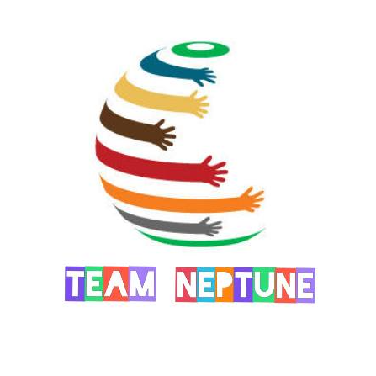
Sri Ramakrishna Engineering College
NGGO Colony, Vattamalaipalayam, Coimbatore, Tamil Nadu 641022, India
New Gen
Innovative Idea 2021
SIGN LANGUAGE TRANSLATOR
Not Disabled, Just Differently Abled
Team Members
Ajay Poudar 1901064
Ayush Dutta 1901067
Andro Benoson 1901012
Notes:
Ayush

Slide 2
Agenda
Introduction
Problem Statement
Flowchart
Modules
Block Diagram
Hardware & Software
Implementation Results
Conclusion
Notes:
Ayush

Slide 3
Introduction
Sign Language Translator also known as (SLT) is a device which is used for the communication of deaf ,dumb and Hemiparesis people through the medium of signs. This device reads the sign language of the deaf people and Convey the message as an output on the monitor. This makes others easy to read it and understand what they are trying to say and express their feelings. So as a whole it will make the demotivated people life into something and hence they will be communicating with normal people without feeling of being disabled.
Notes:
Kuga

Slide 4
Problem Statement
According to reports in 2020, 2.21% of india's population are physically challenged, of which 7.5% are dumb and 5.8% are deaf.
Communication is the biggest hindrance in their life.
Lack of communication leads to lack of opportunities and talents gets unnoticed.
So a gap is built between normal people and them.
This makes them feel unworthy and uneasy, to remove this issue this project is created.
Notes:
Andro

Slide 5
Flow Chart
Pair the device with voice SLT by Neptune App
Yes
Text Output in LCD Display
+
Voice Output through the app
Voice Output Required
Device paired with the app
Wear the Glove
Start
No
Do Your Sign
Yes
No
Text output in LCD Display
Notes:
Andro

Slide 6

Modules
Designing the circuit and building hardware of our product.
Implementing software by Coding Using Arduino.
Sign & Symbol Identification.
Flex signal to text conversion.
Displaying the text in LCD display.
Text to Voice conversion using an app through bluetooth module(HC-05).
Prototype Building.
Testing prototype.
Deployment.
Notes:
Ajay

Slide 7
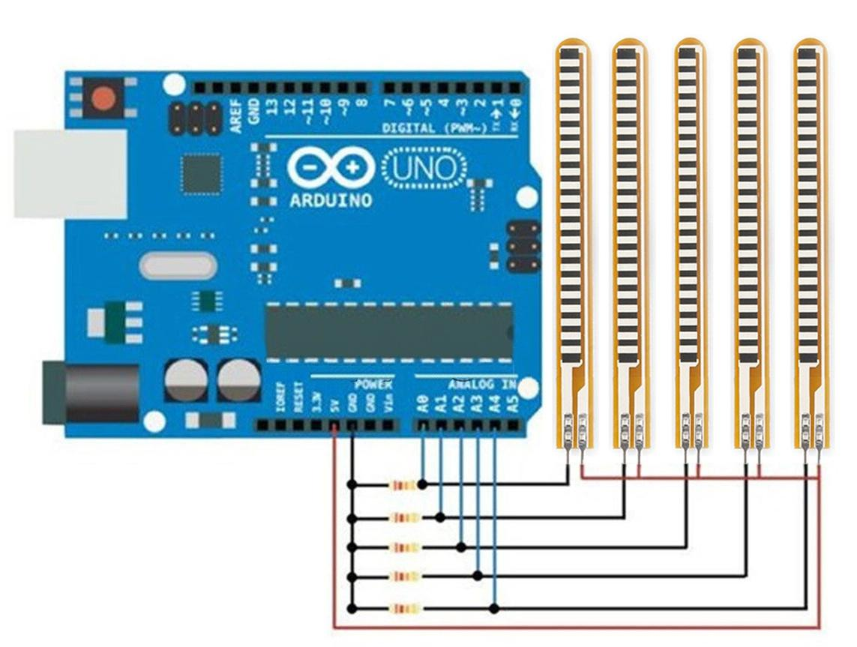
Hardware & Software
Hardware
Arduino Uno
Flex Sensors (2.2”)
47k & 220 ohms Resistors
Jumper Wires
Gloves
16*2 LCD Display
Bluetooth (HC-05)
Software
Arduino IDE
Voice SLT by Neptune app
App Link: https://bit.ly/3xk4cQ

Slide 8
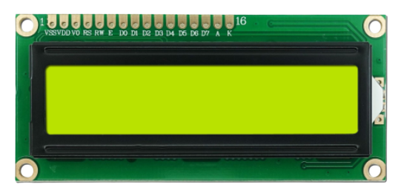
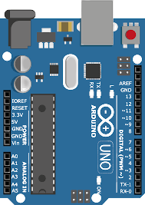
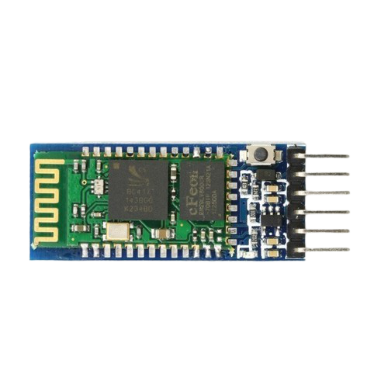
Block Diagram
Text Output in LCD Display
Gloves Of Sign Language Gesture
( Flex Sensor)
Voice Output from Voice
SLT By Neptune app
through Bluetooth
Notes:
Ajay

Slide 9
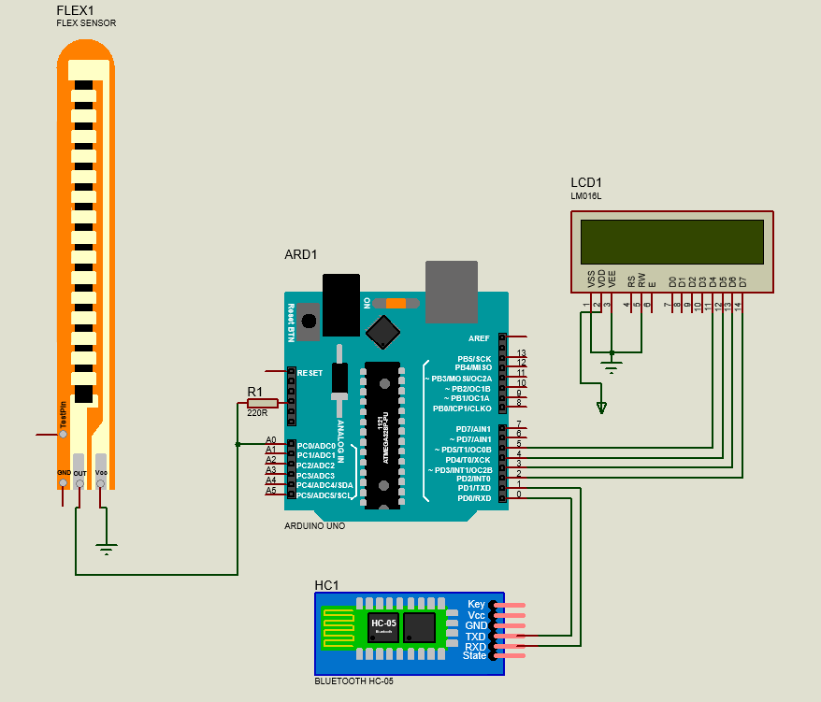
Circuit
Diagram
Notes:
Ajay

Slide 10
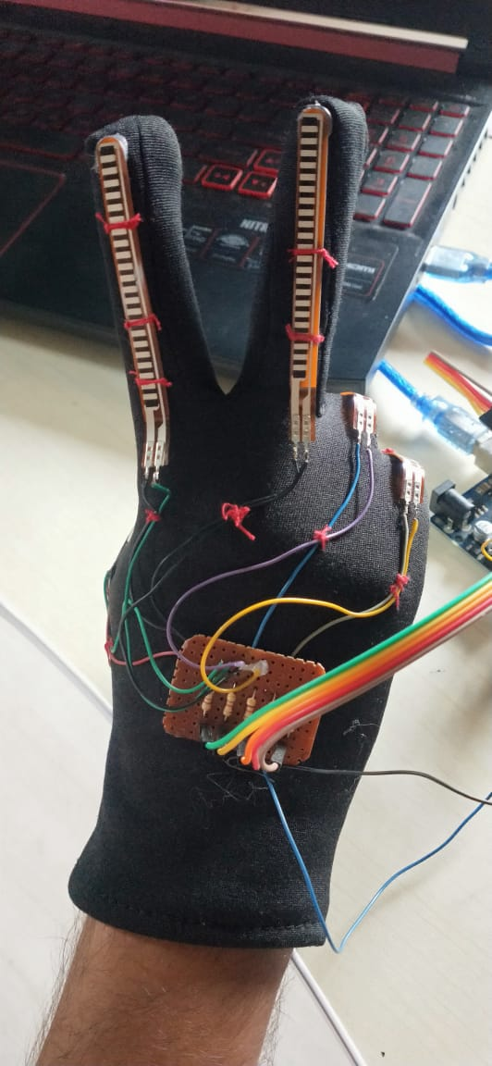
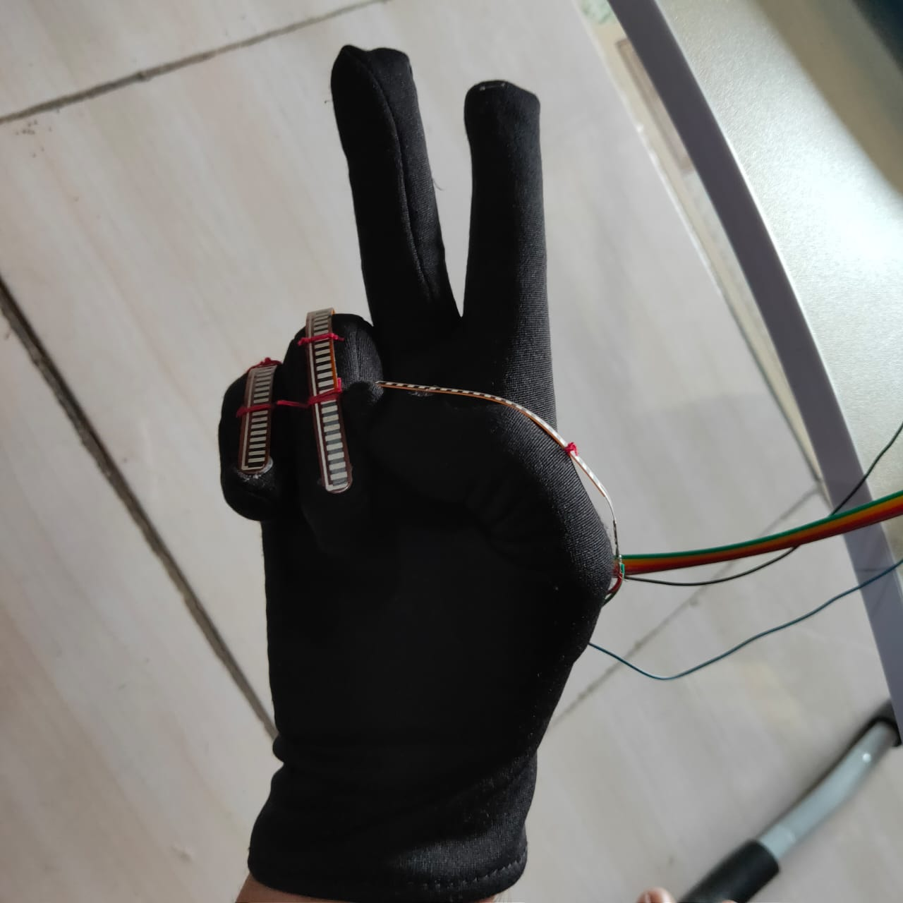
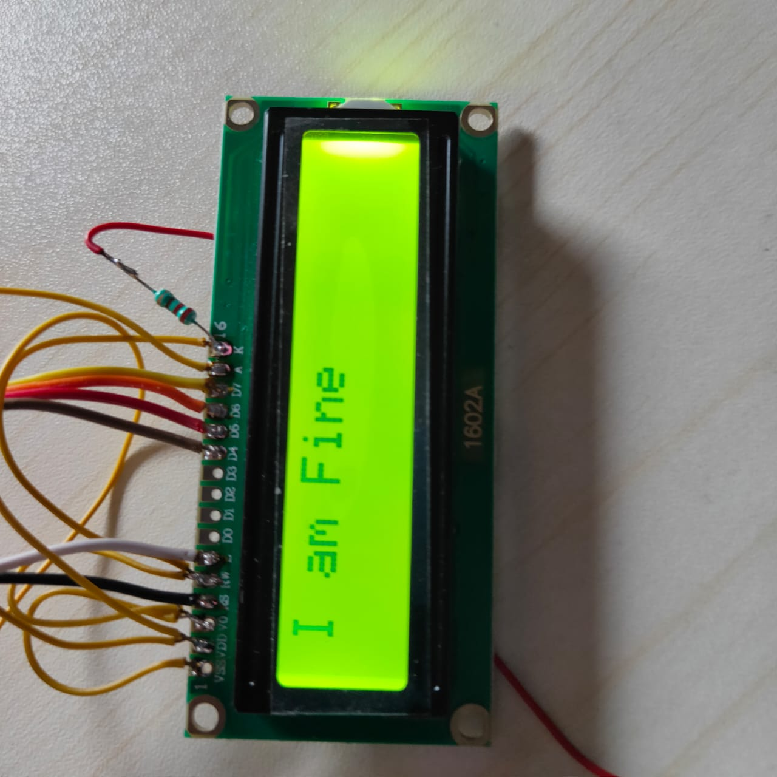
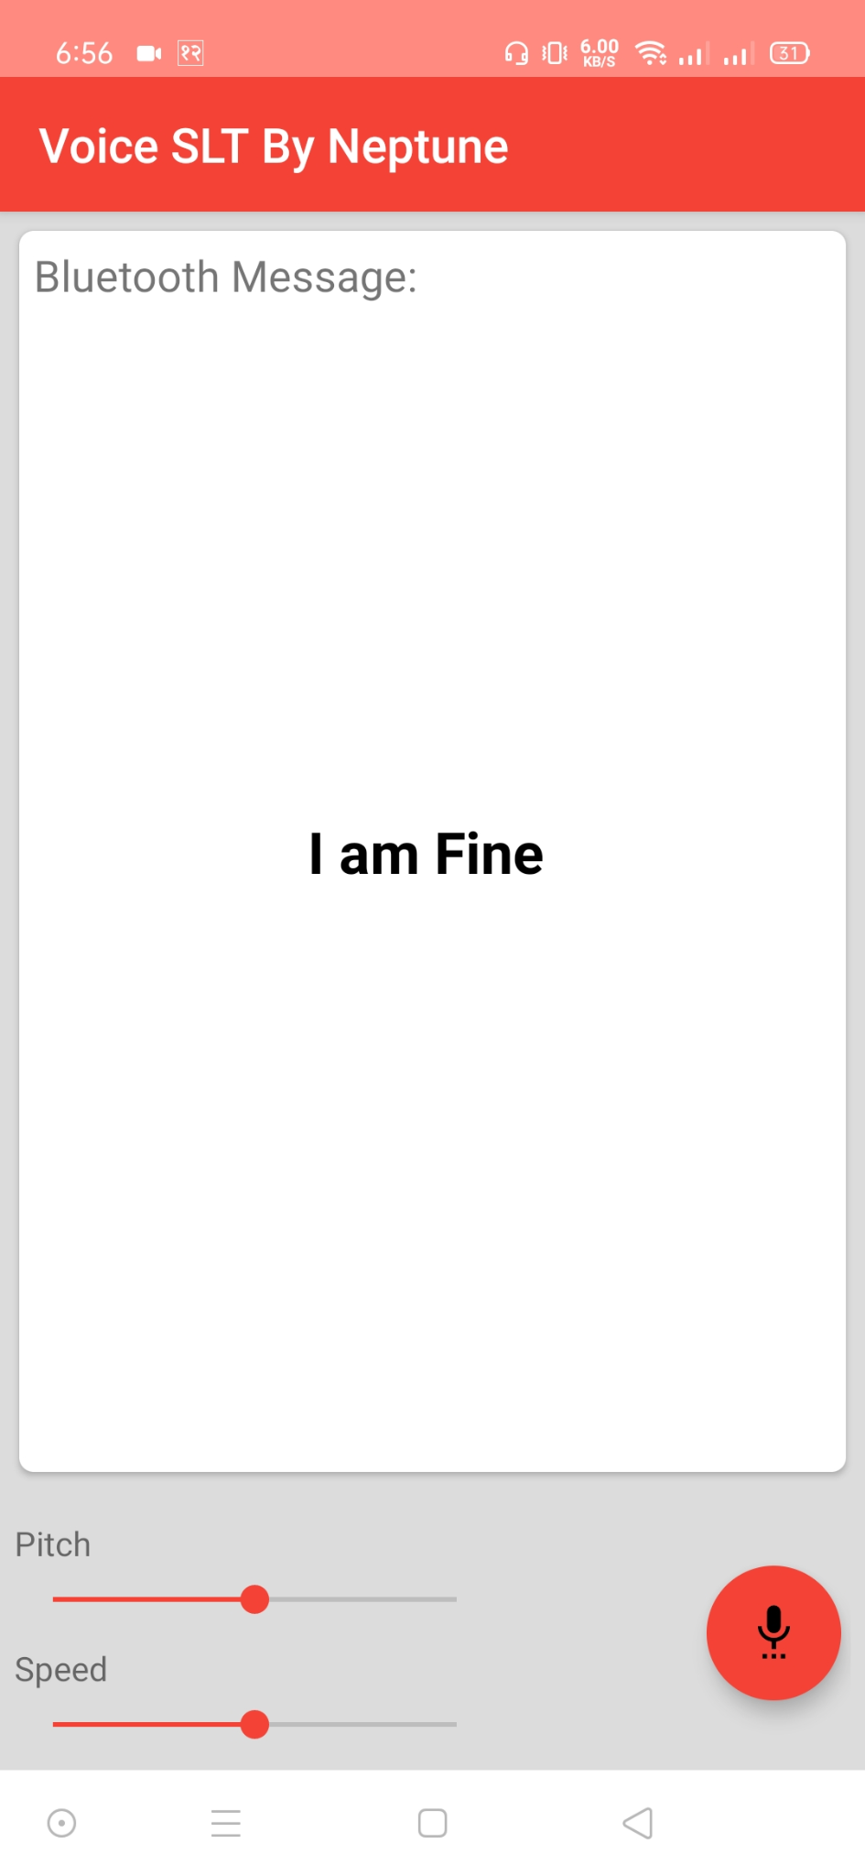
Implementation Results

Slide 11
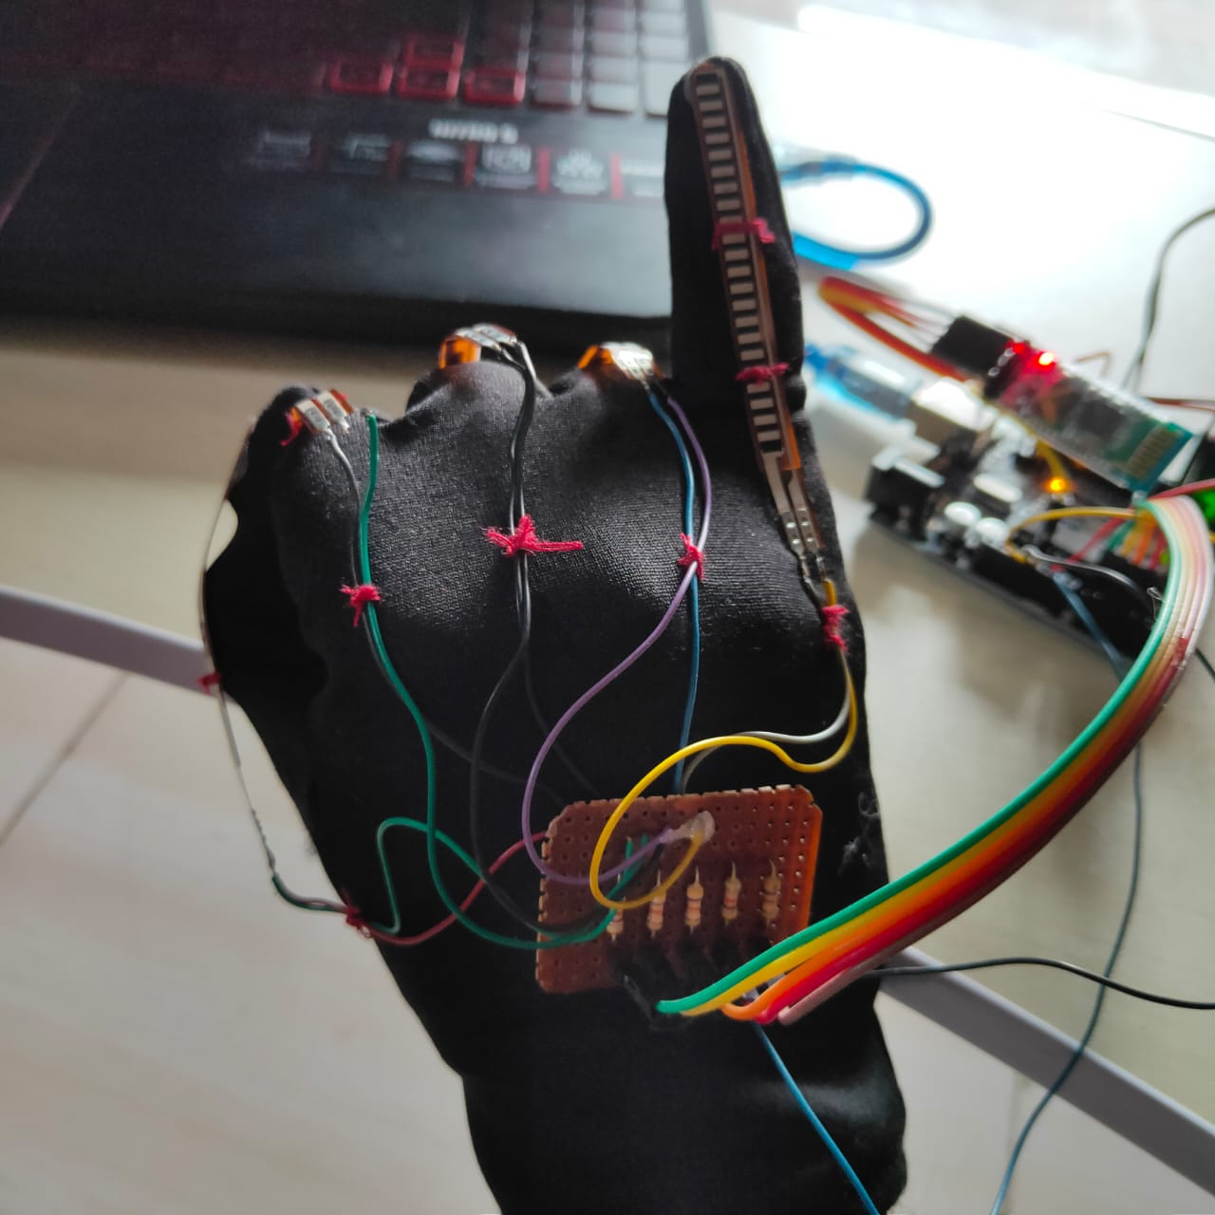
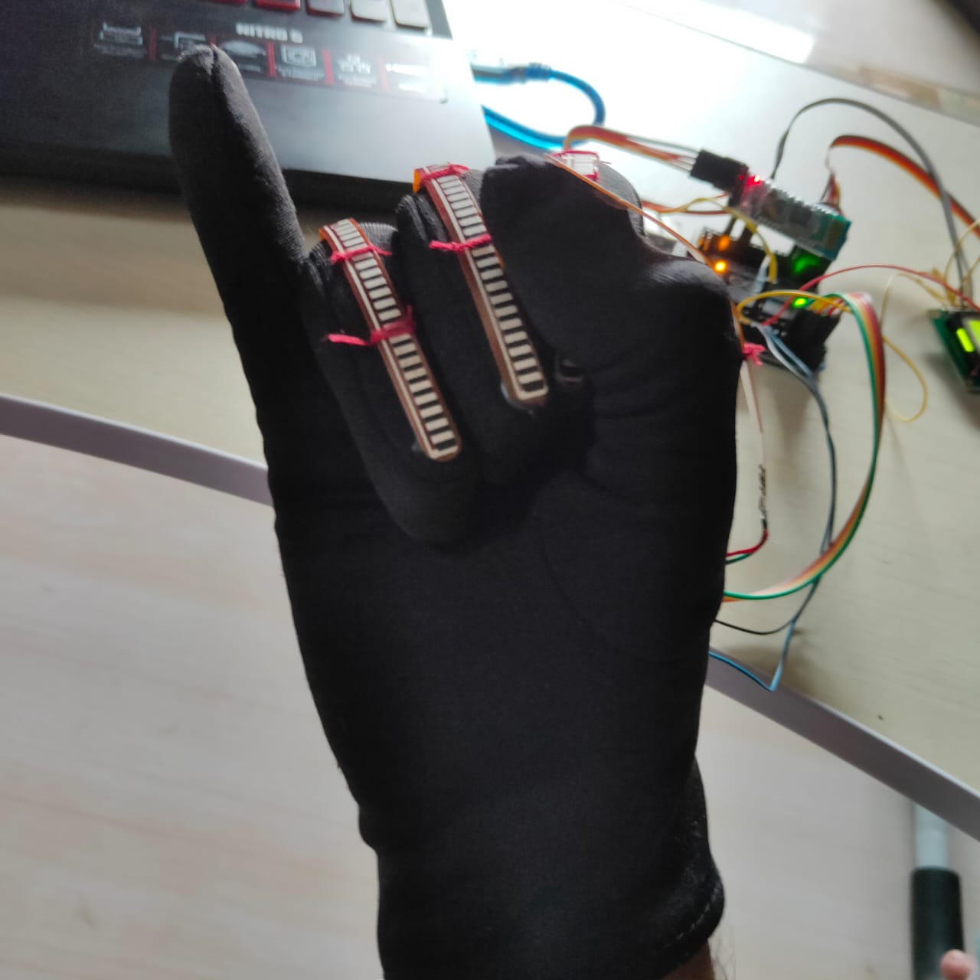
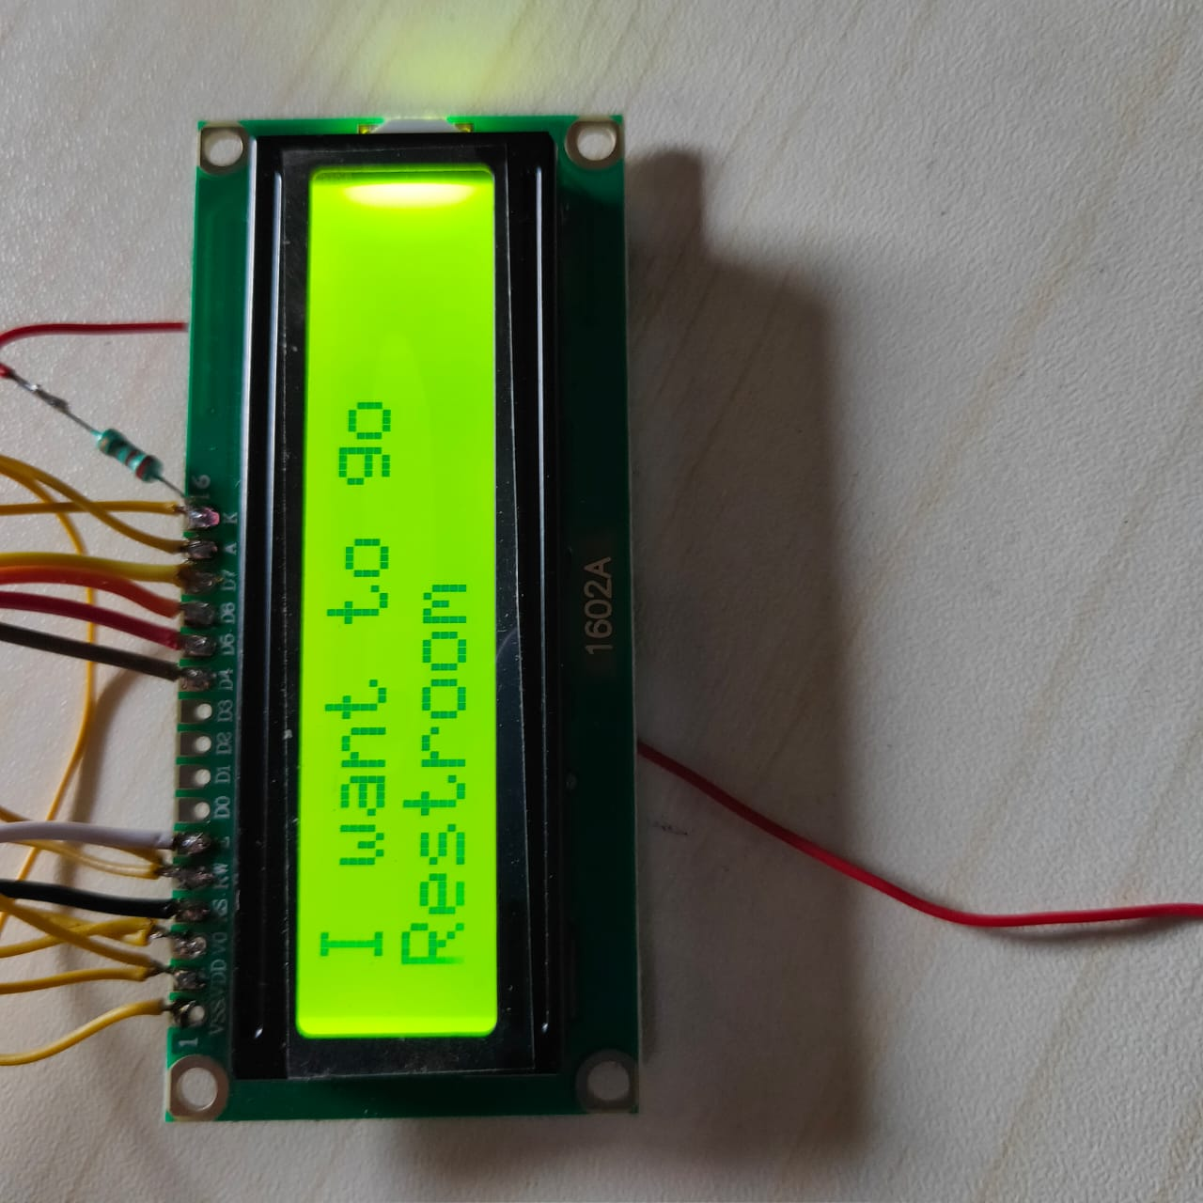
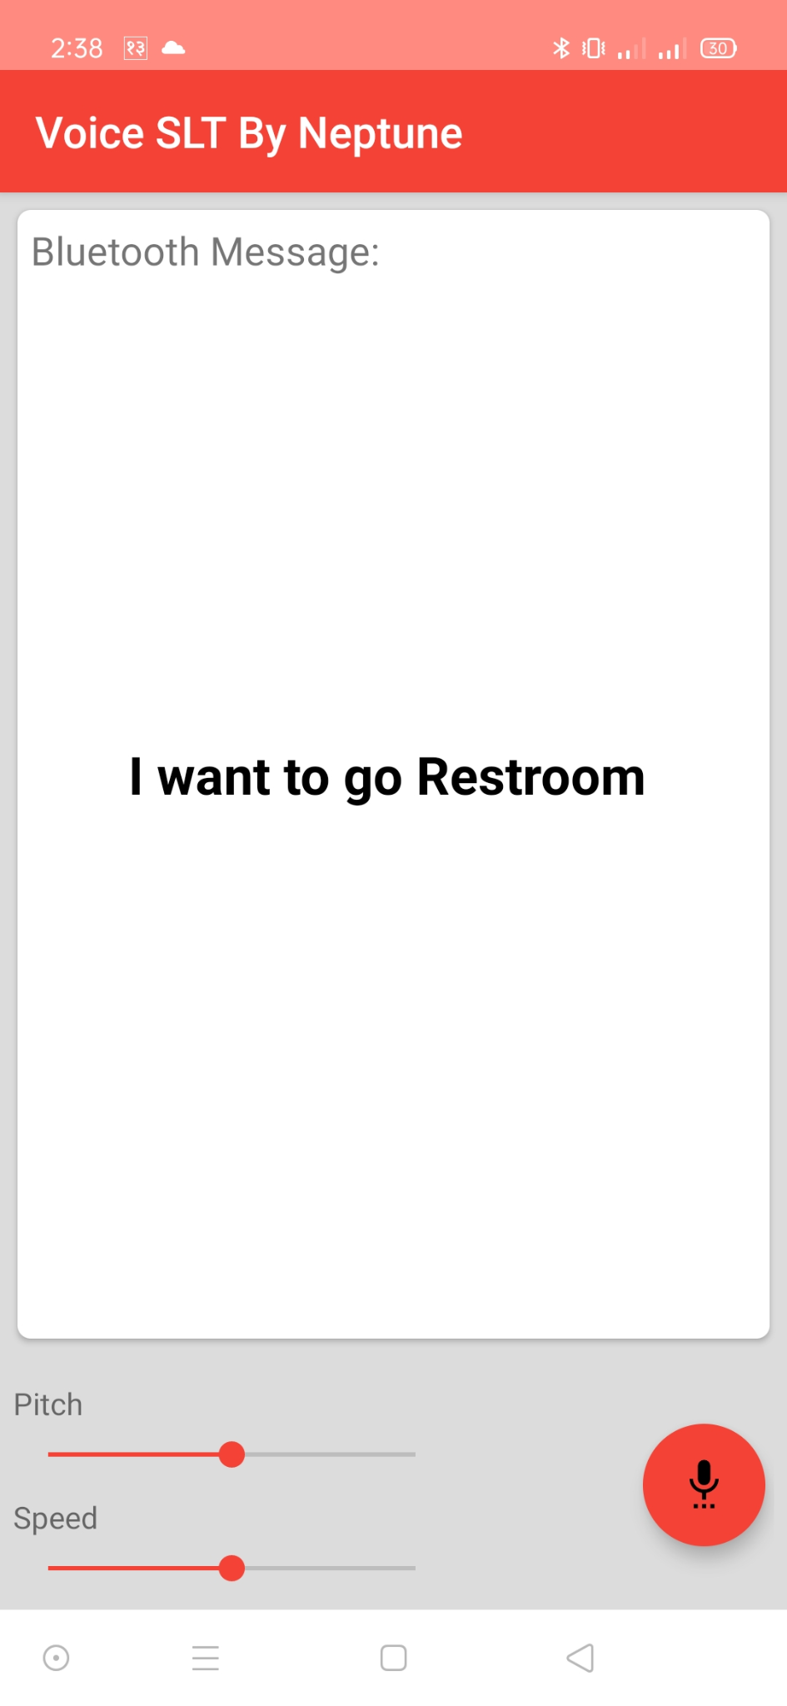
Implementation Results

Slide 12
Conclusion
The sign language translator device will improve the life of differently abled people. The lack of communication which they were facing will be removed from their lives so they get an equal chance to stand and work with normal people so that their talents gets recognized.

Slide 13

THANK YOU
-TEAM NEPTUNE

